Slide 1
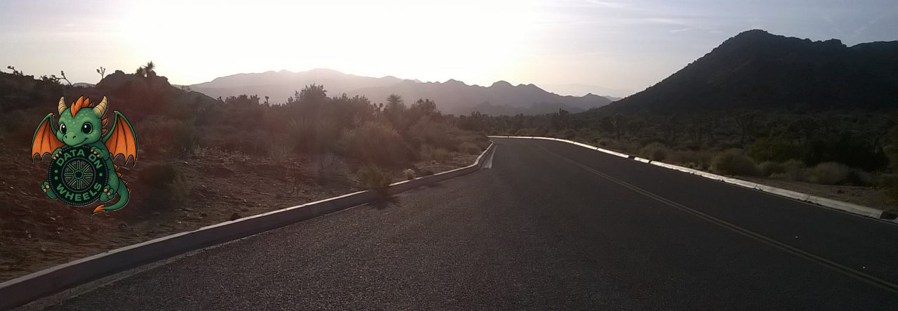
Exploring Real-Time Horizons with Microsoft Fabric
Kristyna Ferris
Fun Fact: this font is dyslexic friendly! Ask me how to use it for free after the session.
Notes:
Open-Dyslexic Font | dafont.com
Download the font from Open-Dyslexic Font | dafont.com
Extract the files
Go to computer settings > personalization > fonts and drop in the files
Navigate to Power Point Master Slide
Change the font to use Open Dyslexic for the headers and body
Done!

Slide 2

About Me ~ Kristyna Ferris
Microsoft MVP, Data Platform & Fabric Solution Architect, P3 Adaptive Lexington Data Tech Group co-organizer DataOnWheels Author
Blog
https://dataonwheels.wordpress.com/ LinkedIn
https://www.linkedin.com/in/kristyna-ferris-dataonwheels/
Twitter & Bluesky
@data_dragoness

Slide 3


Prerequisites
Fabric capacity backed workspace (trial capacities work well for this)
Streaming data source
A working relationship with time — no time travel experience required
Notes:
Don’t be afraid to try this yourself!
An F2 capacity is very cheap, especially if you pause it when you’re not using it.

Slide 4

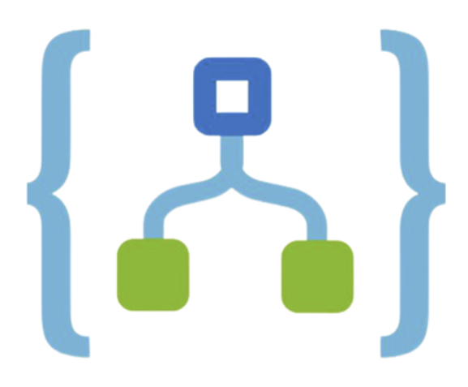





Real-Time Demo Architecture
ISS REST APIs
Logic Apps
Event Streams
Event House
Power BI

Slide 5
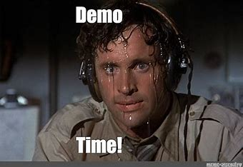

Slide 6
Create Event House
This step is easier than you think! All you need to do is come up with a fun name.
We will not be creating any tables at this stage as those will be added from the Event Streams.
Notes:
Don’t worry about making tables, we will do that during the event stream creation.

Slide 7
Create Event Streams
We have two sources of data (astronauts and ISS location).
So, we need two Event Streams to capture that data.
The source will be a custom app. Hold off on making the destination until after we make the Logic Apps.
Notes:
Do not connect to the event house yet. All we are doing is grabbing the connection string key. You will also need to grab the event stream id.

Slide 8
Create Logic Apps
Navigate to Azure Portal
Create 2 Logic Apps
Don’t forget to add the body of the HTTP response to the Send Event action
Must be a consumption plan
Notes:
This is our only non-Fabric piece of the puzzle.
We will be using free, anonymous REST API to connect to ISS data.
Make sure the logic app is a Consumption app, NOT standard.
You will need to use a custom name for the event stream even after using the connection. The drop down doesn’t work for Fabric.
Use the second connection string.
http://api.open-notify.org/iss-now.json
http://api.open-notify.org/astros.json

Slide 9
Finish Event Streams
Go back to the event streams and connect them to the KQL database.
This will create the tables we will use in Power BI.
Notes:
Test that the data is flowing through then create the tables in the event house.
Don’t forget to activate the connection (not in the editing experience).

Slide 10

Surveying the Data
KQL is not SQL!
The basic syntax of a tabular query is:
TABLE
| operator statement 1
| operator statement 2
Notes:
KQL quick reference: KQL quick reference - Azure Data Explorer & Real-Time Analytics | Microsoft Learn
KQL tutorial: Tutorial: Learn common Kusto Query Language operators - Azure Data Explorer & Real-Time Analytics | Microsoft Learn
ago() - Azure Data Explorer & Real-Time Analytics | Microsoft Learn

Slide 11

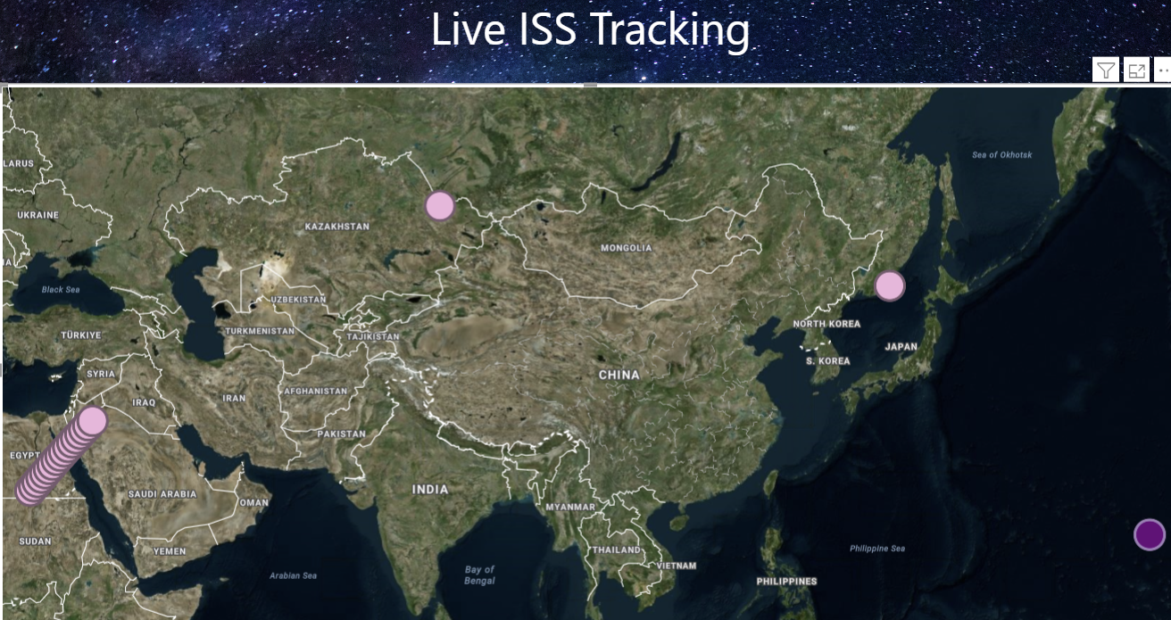
Create Power BI Report
Let’s pull in our latest timestamps to see the latest positions of the ISS.
By enabling the page refresh, we can see it move in near real time!
Notes:
Page refresh in power bi is in the capacity settings
How to configure workloads in Power BI Premium - Power BI | Microsoft Learn

Slide 12
Real-Time Demo Architecture
ISS REST APIs
Logic Apps
Event Streams
Event House
Power BI

Slide 13

Questions?

Slide 14
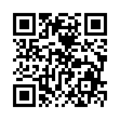
Don’t forget to connect, thanks for listening!
https://dataonwheels.wordpress.com/
kristyna@dataonwheels.com
@data_dragoness
GitHub

